Slide 1
Source Code Authorship Attribution and Verification under
Adversarial
Team 16: Elang Sisson and Andrew Varkey
Notes:
Our project explores how adversarial transformations can evade code authorship detection models while keeping functionality intact.

Slide 2
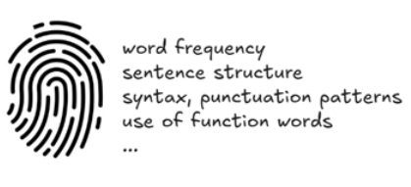
Project Overview / Problem Statement
What is Stylometry? Quantitative analysis of writing style. Leverage statistical and computational methods to learn about authors’ unique stylistic features.
Authorship Attribution: Most likely author of a text among a set of candidates (multiclass classification)
Authorship Verification: Whether a given document was written by a specific, named author or not.

Slide 3
Sprint 1 objectives
Define project scope
Build initial threat model (black/gray/white box)
Draft requirements and use cases
Create and organize a repository to hold code and docs related to the research project

Slide 4
Requirements Gathering Process
Met weekly as a team and held regular client discussions
Conducted 3 client meetings so far: Sept 9, Sept 30, and Oct 3, 2025
Requirements were collaboratively derived with the client, who is also an active research partner
Since this is a research project, key requirements may change as we refine our approach

Slide 5
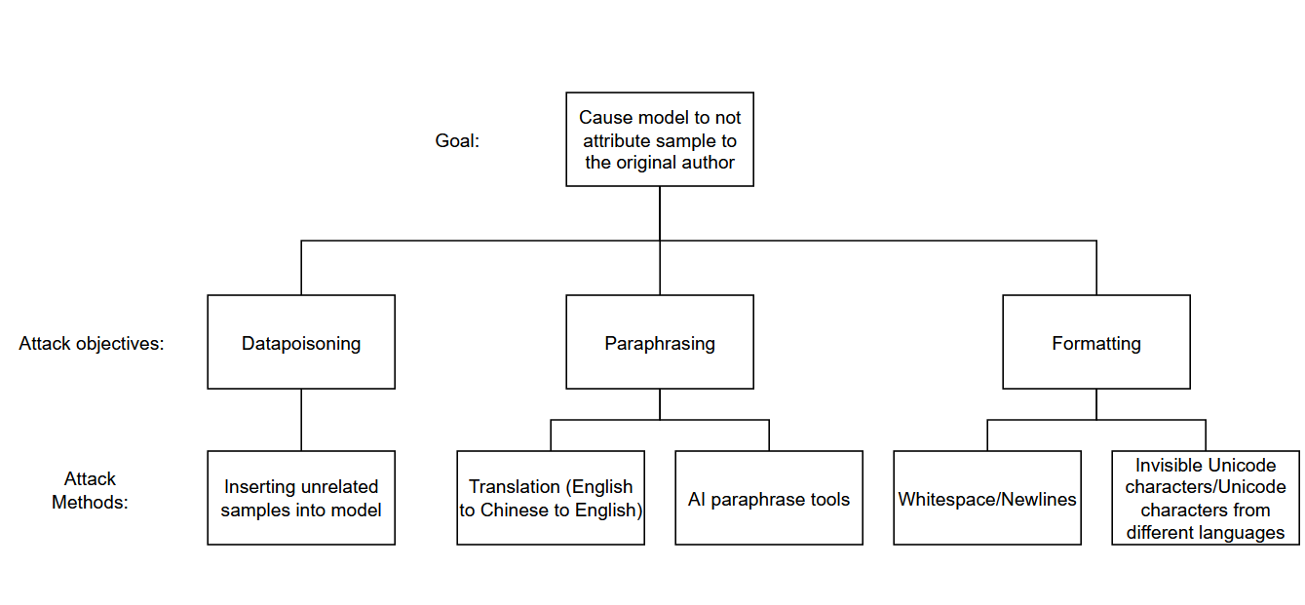
Threat Model
Focus on adversarial transformations that can evade code authorship and verification while keeping the same functionality.
Black box, gray box, white box

Slide 6
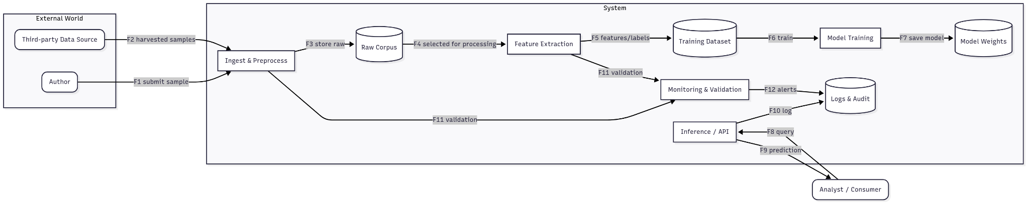
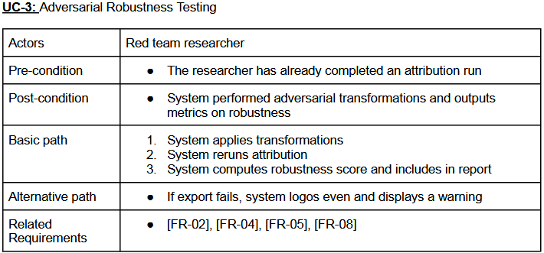
Documentation of User Stories, Use Cases, and UML Diagrams
User stories:
US- 01 - Analyst uploads code for authorship attribution
US- 02 - Researcher verifies a claimed author with scores
US -03 - Red team user applies adversarial transformations and re evaluates attribution
Use cases: Academic integrity check, security incident response, and adversarial robustness testing.
Diagram: Visualization of how these stories and use cases interact across the pipeline (upload → ingest → train/infer → analyze).
Notes:
Talk about one of the use cases from the requirements and specifications assignment

Slide 7
Research and Existing Solutions
No direct access to original codebase yet
The current model’s purpose is to analyze code stylometry – Identifying who wrote a piece of code based on their programming style
Lack of robustness as no threat modeling or adversarial testing have been performed yet
Current process assumes inputs are trustworthy and has not been tested against out attacker-style manipulations

Slide 8
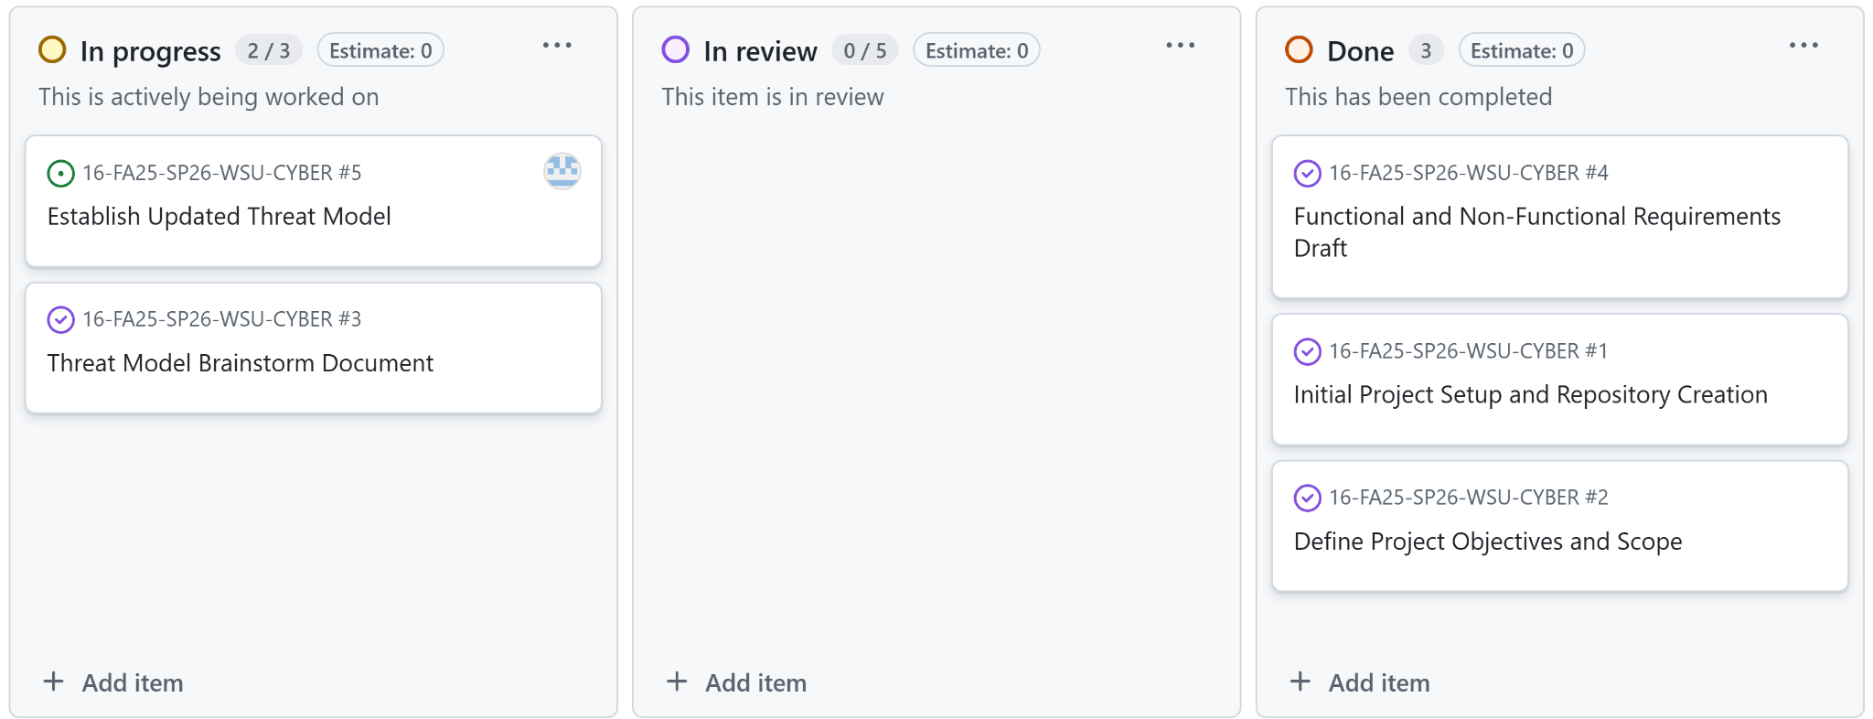
Kanban Overview & Team Contributions

Slide 9
Skills and Learning Process
Elang Sisson (Threat Modeling & Adversarial ML)
Skill Set Identified: I needed to learn Threat Modeling and Adversarial Machine Learning concepts for stylometry-based authorship attribution
Learning Resource: Studied STRIDE, OWASP ML Security Top 10, PLOT4AI Docs, and various online resources.
What I Learned: How to build threat models across black/grey/white box scenarios, how non-functional code edit’s can produce adversarial examples; and how to design experiments to test and later harden the attribution.
Andrew Varkey (Threat Modeling & Adversarial ML)
Skill Set Identified: I needed to learn Threat Modeling and Adversarial Machine Learning concepts for stylometry-based authorship attribution.
Learning Resource: Studied STRIDE, OWASP ML Security Top 10, PLOT4AI Docs, and various online resources.
What I Learned: How to build threat models across black/grey/white box scenarios, how non-functional code edit’s can produce adversarial examples; and how to design experiments to test and later harden the attribution.

Slide 10
Sprint Achievements and Challenges
Defined clear attacker taxonomy and access models
Created first version of Threat model Document
Established Github Repository and team workflow
Achieved alignment on project goals and deliverables

Slide 11
Responsible Use of Generative AI
Our team used ChatGPT in limited and transparent ways. ChatGPT was only used in assignments that required it.

Slide 12
Next Steps and Conclusion
Defined clear attacker taxonomy and access models
Implement baseline authorship attribution model
Develop initial adversarial attack method for layout-level obfuscation
Continue refining Threat Model and add defender-side countermeasures
Document experimental pipeline setup on Github

